Slide 1
Ranking the locations and predicting crime occurrence based on the news from online newspapers.
GROUP MEMBERS
Rajib Chandra Das (#2009331008)
Md. Ruhul Amin (#2009331011)
Md. Jumman Hossain (#2009331054)
SUPERVISOR
Md. Saiful Islam
Lecturer, Dept. of CSE,SUST.

Slide 2
Introduction
Constantly, there have lots of crime happening all around. Most crime is not reported to the police so there is lot of room for error.
National Institute of Justice release crime survey data for the country based on reported and unreported crime and does not offer crime statistics for states, metro areas or cities.
Our solution collects crime information from different online newspapers and point them on a local map with ranking.

Slide 3
What is information retrieval?
Information retrieval is the activity of obtaining information resources relevant to an information need from a collection of information resources. Searches can be based on metadata or on full-text (or other content-based) indexing.

Slide 4
Our Goal
Our goal is to design a future crime occurring prediction system alongside area based crime ranking. Where, to get the crime occurrence of different locations have been collected after crawling different news from different Bangla online newspaper

Slide 5
Why this crime ranking?
Our system provides a map where different crime has been pointed according to their occurrence zone. This will definitely be helpful for general people, tourists to decide their outing and police to know where the crime is happening frequently.

Slide 6
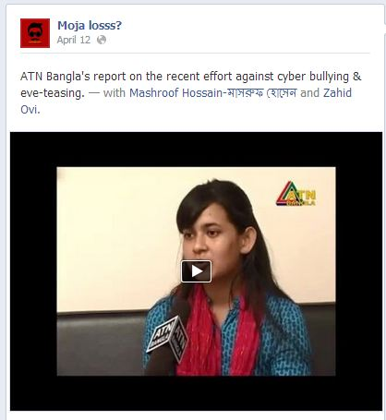
Some recent online activities?

Slide 7
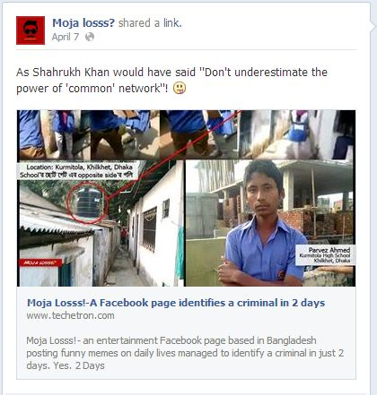
Some recent online activities?

Slide 8
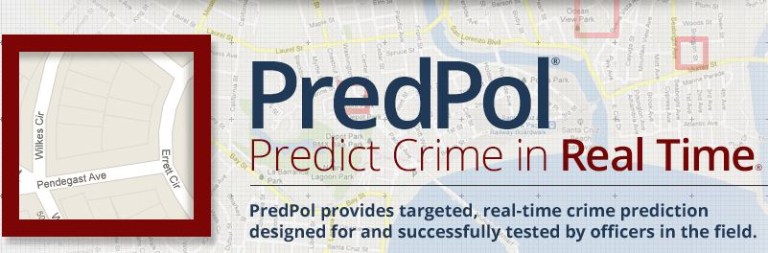
Related work:

Slide 9
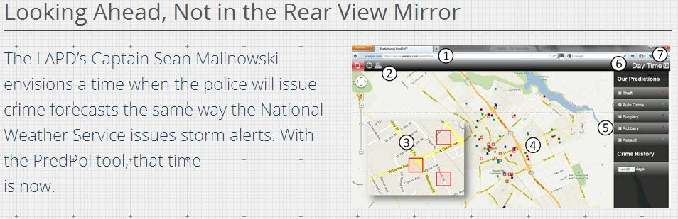
Related work (continued):

Slide 10
What do we need to know??
Web Crawler
Parsing
Stop-word listing and Stemming
Keyword Extraction
Categorization
News similarity finding and same news detecting

Slide 11
What do we need to know?? [algorithm]
Cosine Similarity with TF-IDF
Jaccard Similarity
K-means Clustering
Naïve Bayes Classifier
Hidden Markov Model
Statistical Analysis

Slide 12
Implementation
Parsing the crawled News
Indexing root words and stop words
Extracting Top words from news
Categorizing the news
Extracting Location and dates
Finding Similarity of different News

Slide 13
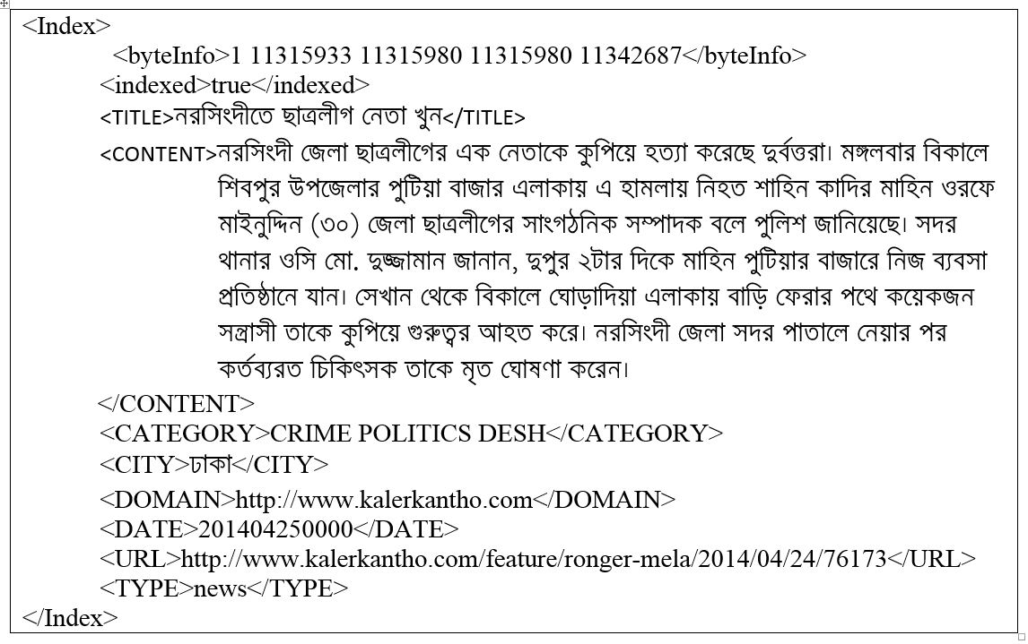
Parsing The Crawled News
We collected Crawled News from Pipilika Bangla Search Engine.

Slide 14
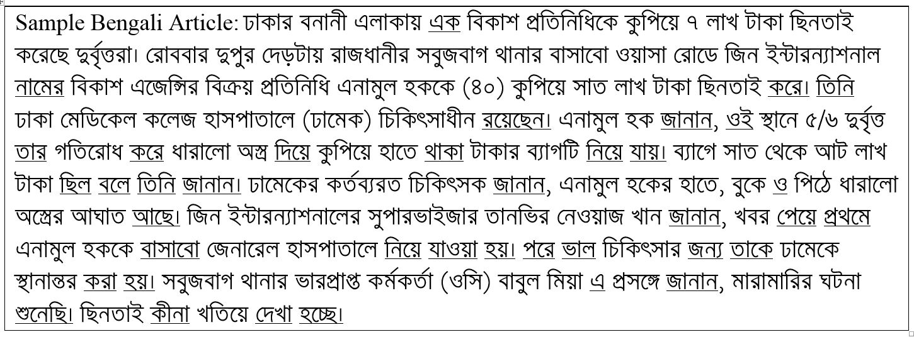
Indexing Stop words
We have studied about more than 500 news articles and observed that every Pronoun(সর্বনাম) and Conjunction(অব্যয়) are stop words.
We can also add several verb(ক্রিয়া) and Adjective(বিশেষন) words to stop word list.
Actually we need all the Nouns (বিশেষ্য), several verbs (ক্রিয়া) and adjectives (বিশেষন).

Slide 15
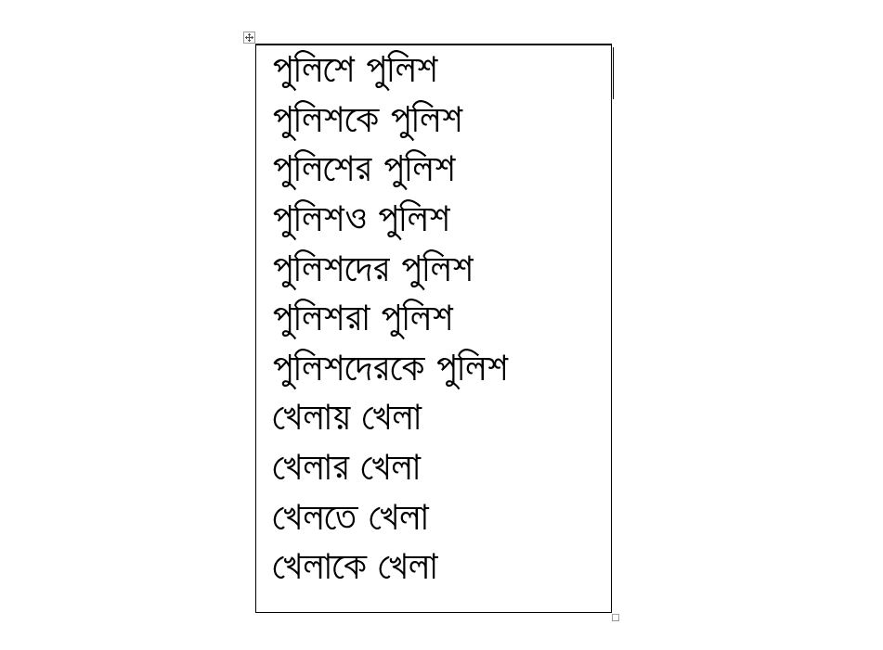
Indexing Root Words
There are more than 40,000 words are used in bangladeshi news articles. In order to compute root word from a sample word we have to study about bangla grammartical rules (পদ, প্রকৃতি, প্রত্যয়, উপসর্গ, কারক, বিভক্তি, সন্ধি-বিচ্ছেদ) and also required some natural language processing.
We stored more than 4,500 words and corresponding root word in a text file.

Slide 16
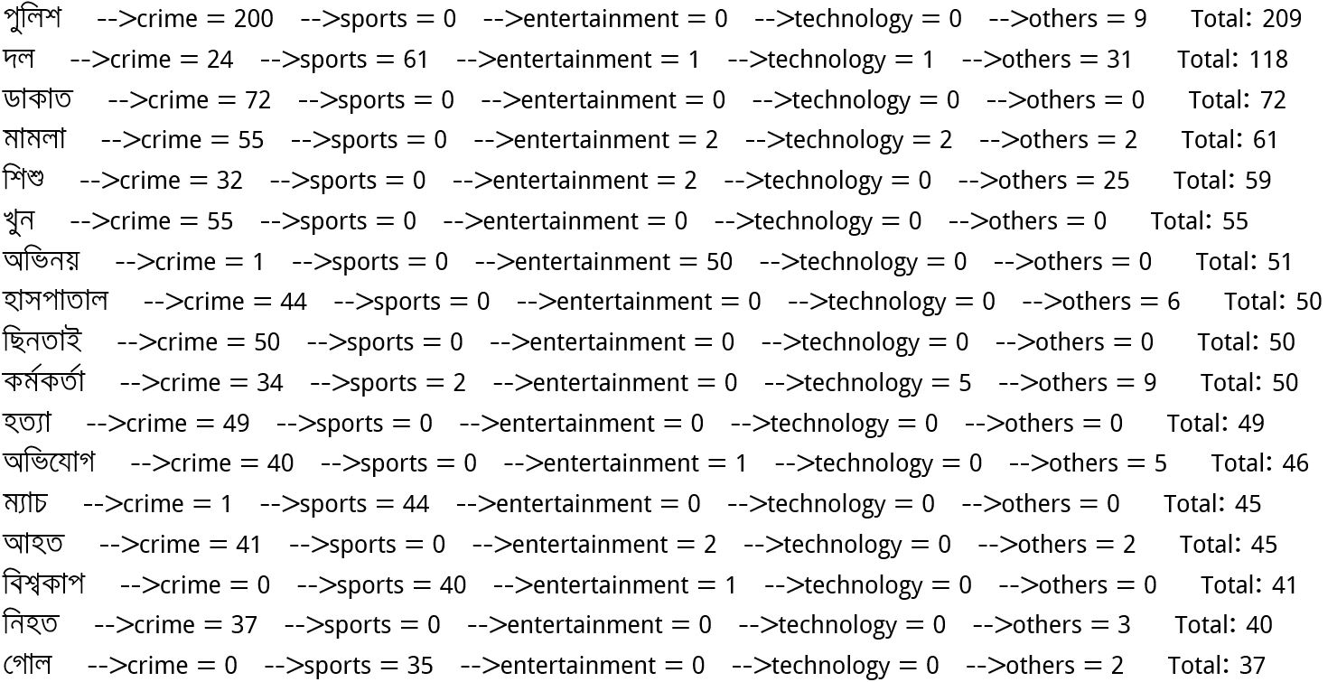
Extracting Top words from news
We picked top words from about 250 news articles
We counted term frequency for every term.
Most frequent term is considered as top words.

Slide 17
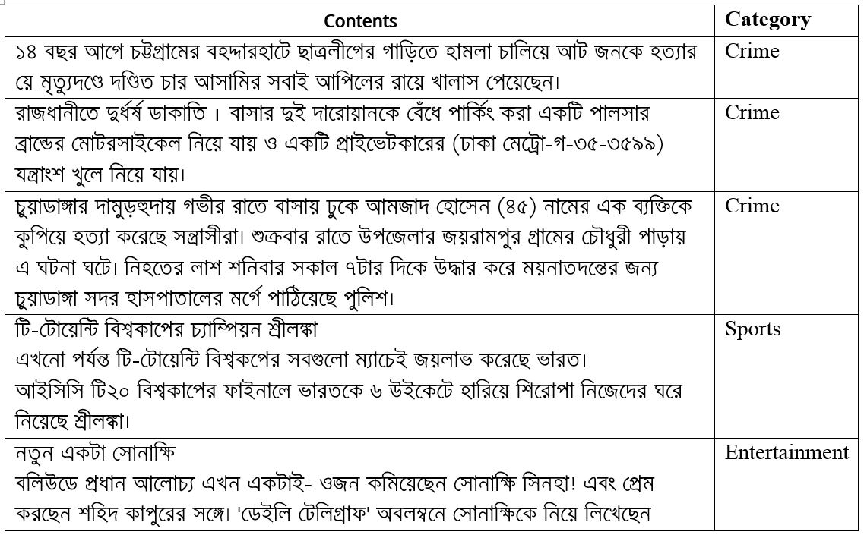
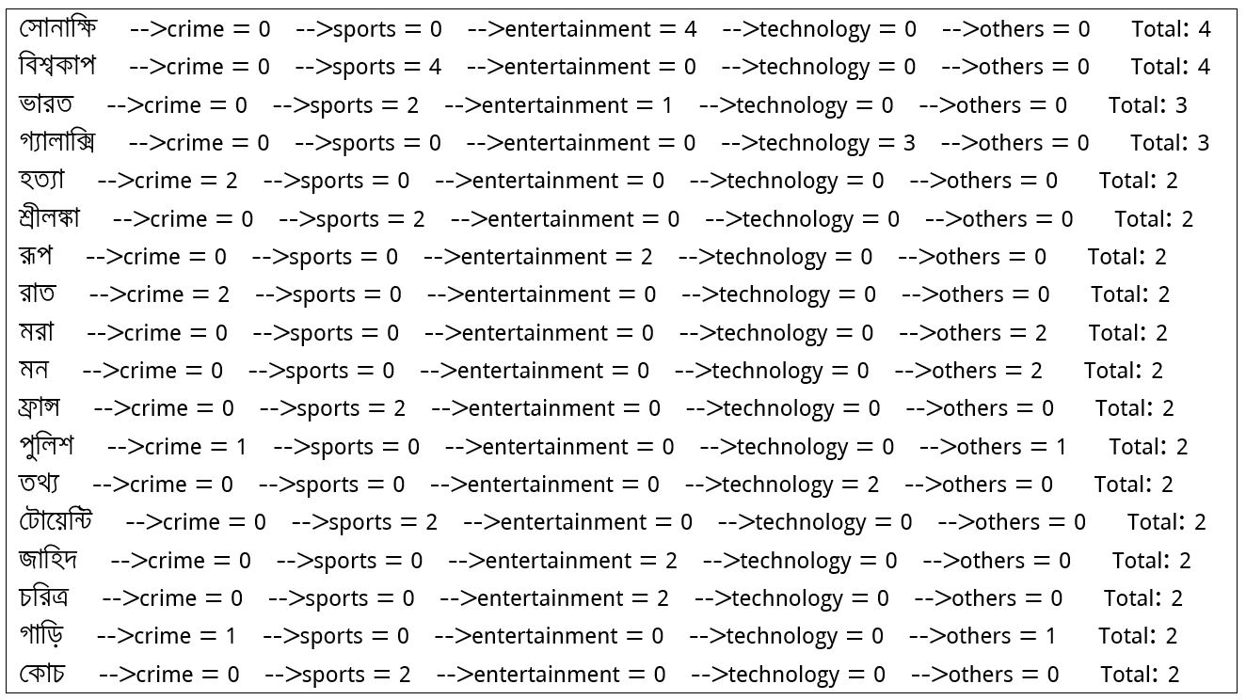
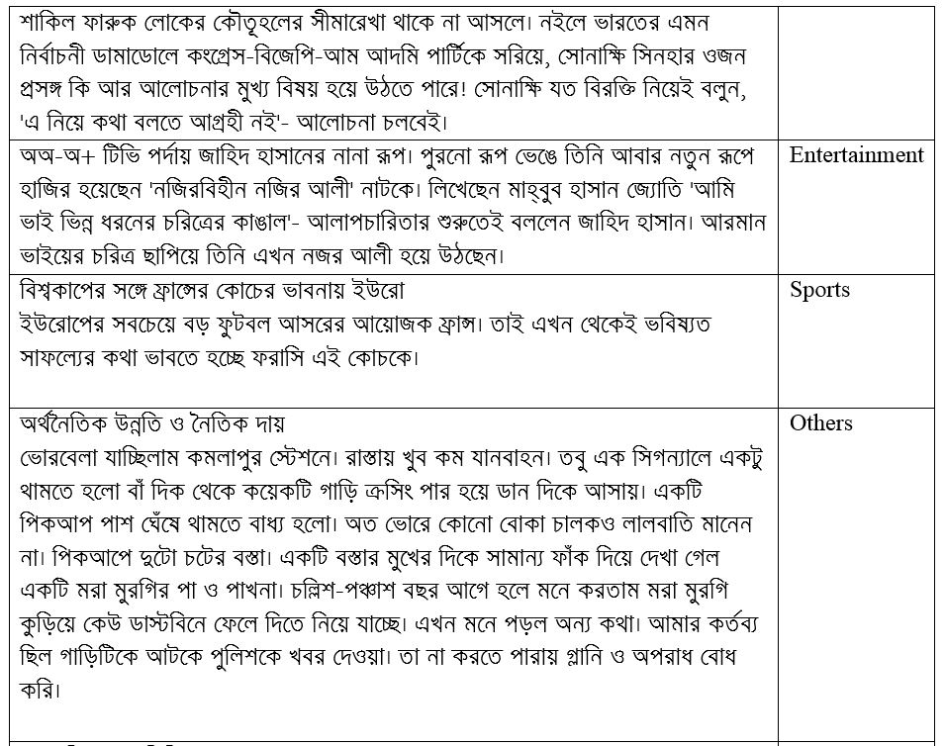
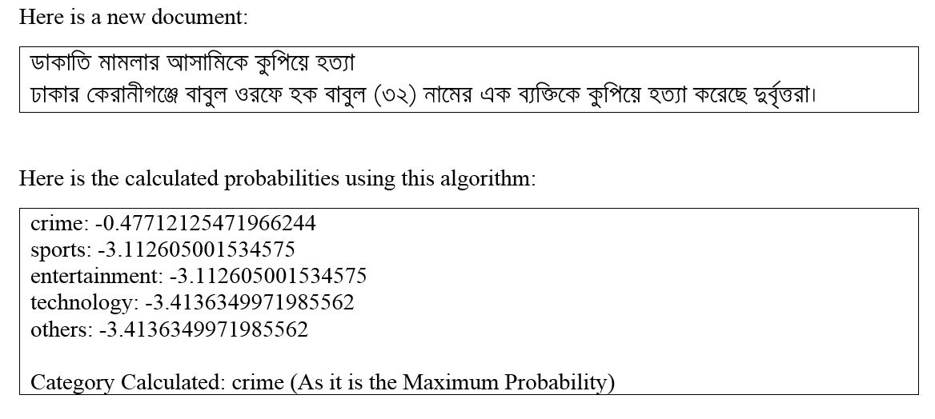
Categorization of News
We used Naïve bayes Clustering for News Categorization
We require accurate training data set for this categorization

Slide 18
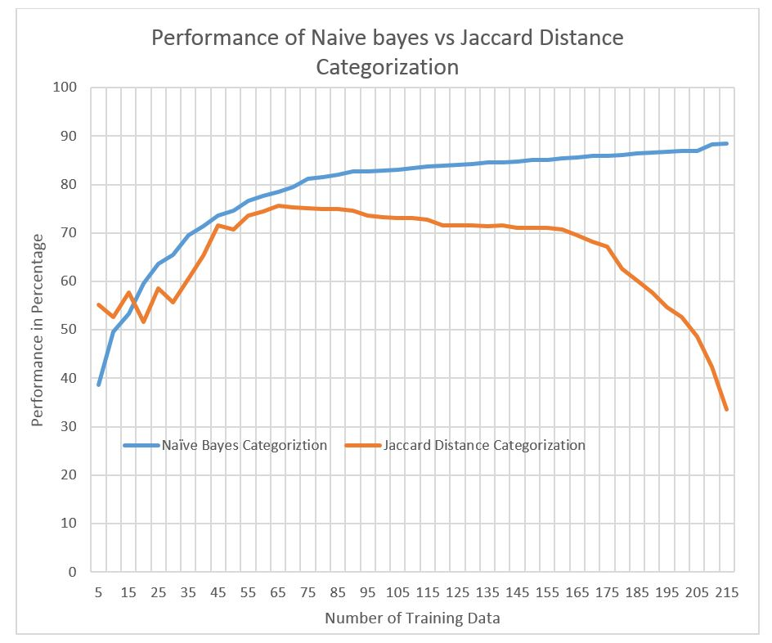
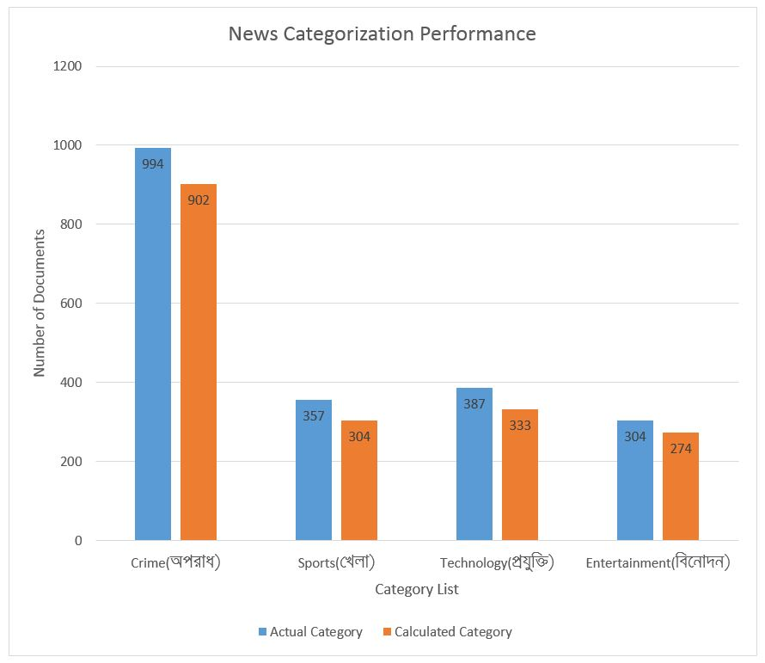
Performance Analysis of News Categorization

Slide 19
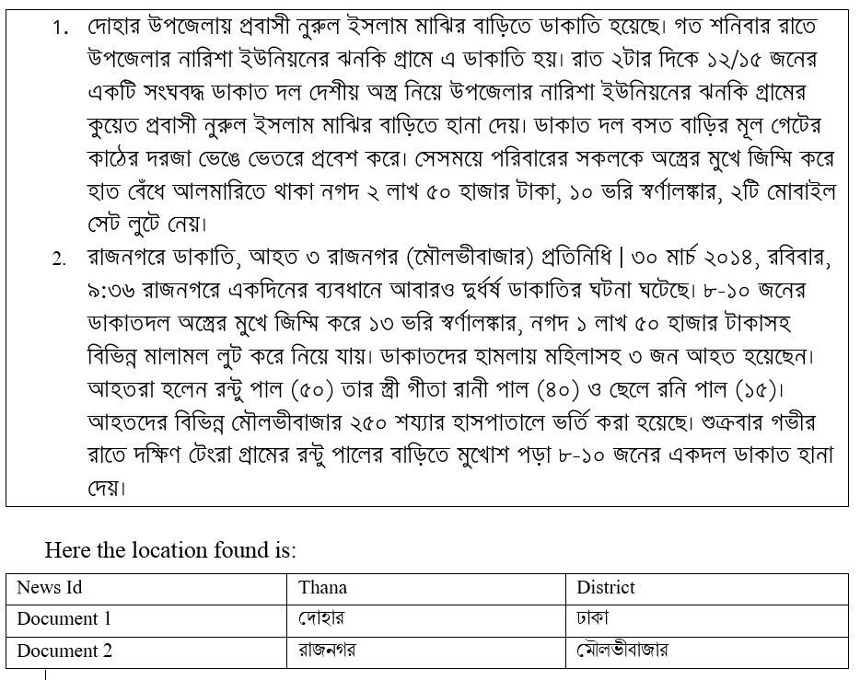
Extracting Location and Dates

Slide 20
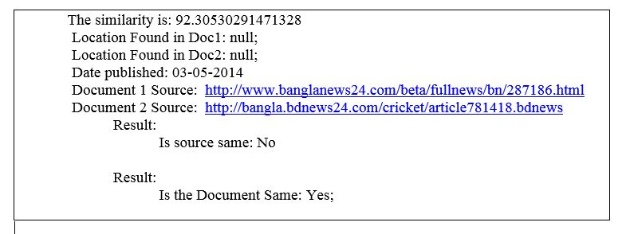
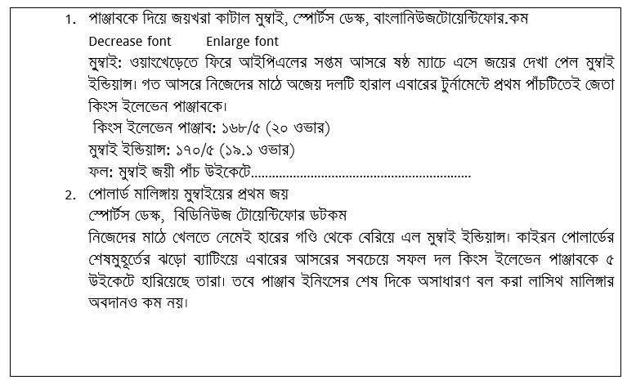
Finding and Removing the Same News
A single news can be published in different newspapers.
To calculate this we use cosine similarity for matching the document and then find the location and published date.

Slide 21
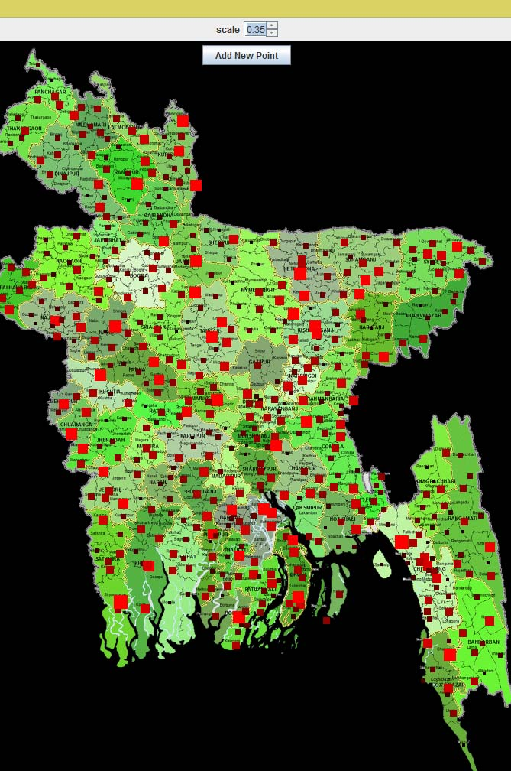
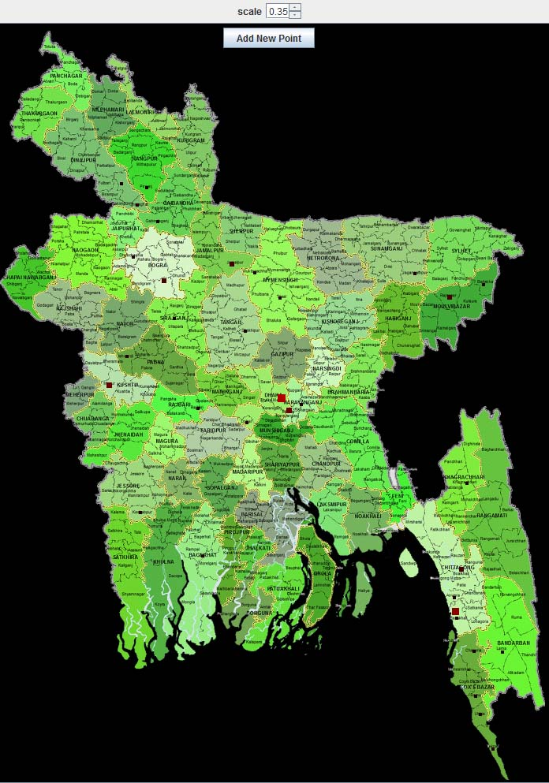
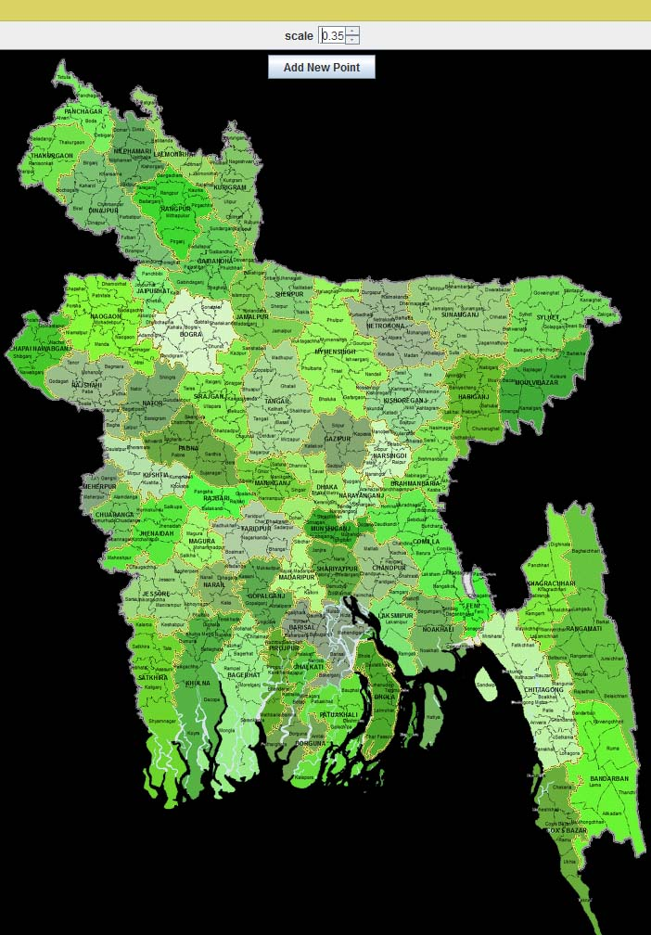
Mapping the Extracted Data
We have a static High Quality Map of Bangladesh which have a resolution 2000 x 2731 (BangladeshMap.png). This map shows us all Divisions, Districts and Thanas of Bangladesh.

Slide 22
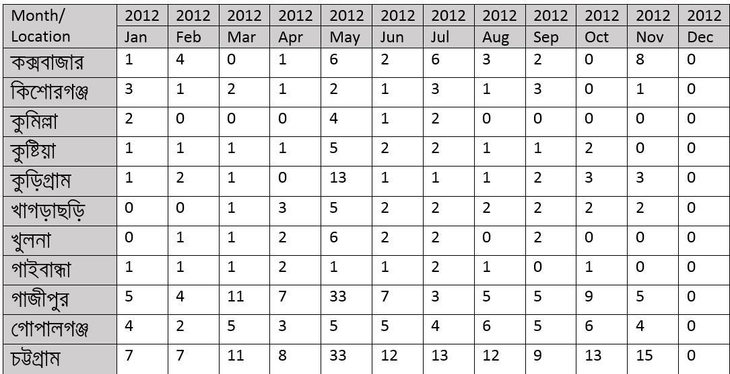
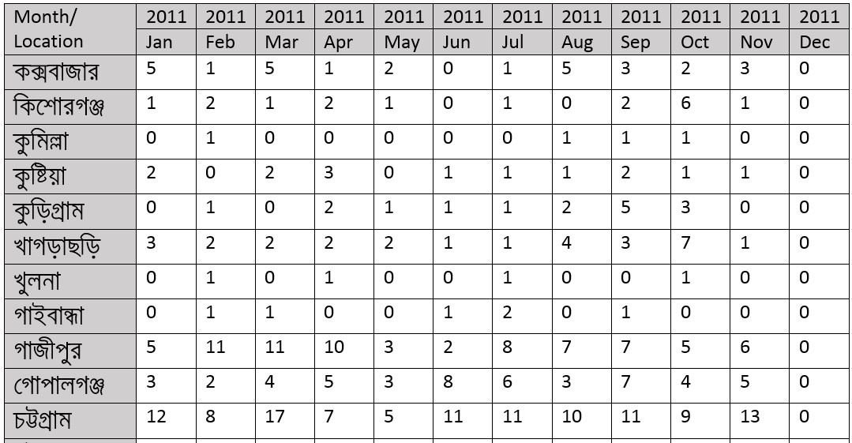
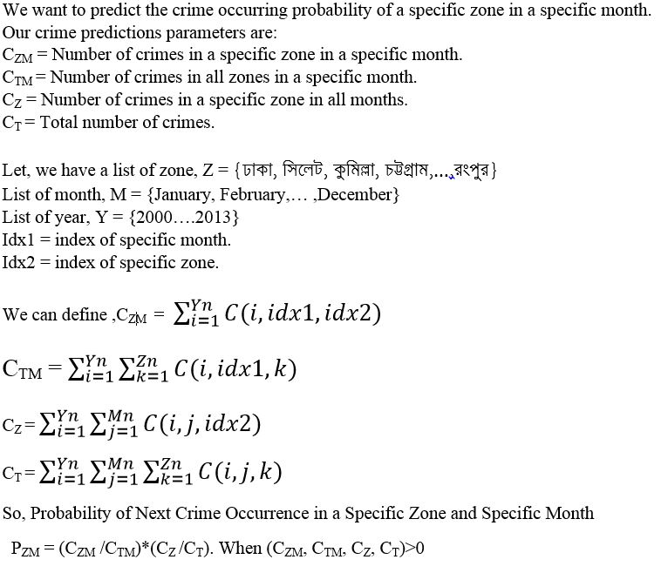
Measuring Crime Occurrence Probability
Here we developed a statistical approach to predict the crime occurrence in a specific zone and specific time duration.

Slide 23
Limitation
We were required about 30000 root words but we worked with only 5000, so there have an option improve the root word finding algorithm.
Here we do not finding any keywords actually, to categorize the news we have taken only the specific top words. Better accuracy can be gained through finding the key words.
To find the locations we have find only up to Thana but if there have any union that haven’t identified yet.
We have used a static map to show the crimes of specific locations, but it can be pointed better through using Google map.

Slide 24
Future Work
There have some important scope to develop our approach, like:
Finding the keywords dynamically with designing a smart algorithm.
Developing a dynamic algorithm for root word finding.
We have tried to design a better crime prediction algorithm, but it’s possible to design a better approach using machine learning techniques.

Slide 25
End of the presentation !
Thanks to all ☺

